Slide 1
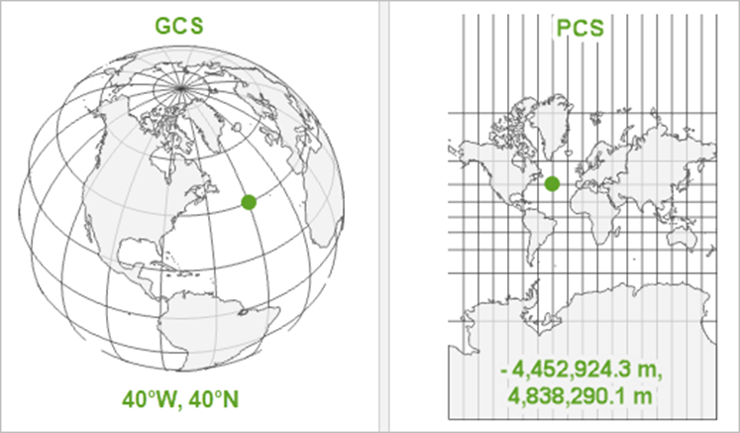
CRS continued…
There are two Main CRS:
Geographic Coordinate System vs Projected Coordinate Systems
The ‘where’
The ‘how’

Slide 2
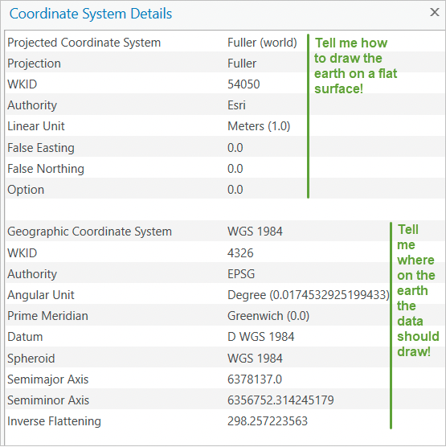
CRS example
Remember that a PCS, is just a GCS that has been projected !

Slide 3
References
https://www.esri.com/en-us/what-is-gis/overview#liSwitcher
https://blog.ukdataservice.ac.uk/gis-spatial-data/
Dermanis (2005) : https://www.researchgate.net/profile/Athanasios-Dermanis/publication/233387161_Coordinates_and_Reference_Systems_in_Greek/links/0912f50a149d9568b7000000/Coordinates-and-Reference-Systems-in-Greek.pdf
Luc Anselin (2009) : https://link.springer.com/chapter/10.1007/978-3-642-03647-7_5
Ratcliffe (2009) Spatial and Temporal Challenges: https://link.springer.com/chapter/10.1007/978-0-387-77650-7_2
Bowers (2001) Mapping and Analysing Crime Data : https://link.springer.com/chapter/10.1007/978-0-387-77650-7_2
https://core.ac.uk/download/pdf/161890428.pdf
https://www.ed.ac.uk/files/imports/fileManager/chainey.pdf
https://www.crimrxiv.com/pub/slkb1v54/release/1
https://tubecreature.com/#/livesontheline/current/same/U/*/FFTFTF/11.469326848406268/-0.1622/51.5142/
https://www.crimrxiv.com/pub/slkb1v54/release/1

